Slide 1
Rehabilitation
Dr.Doss Prakash S
Professor & Head
Dept Of Community Pt
MGM Institute Of Physiotherapy
Chh.Sambhajinagar

Slide 2
It is restoration of ability to function.
It is to support the
patient with an injury or
disability illness to achieve maximum function and
independence
Rehab

Slide 4
W.H.O define rehabilitation as
“the combines and coordinated use of
medical, social, educational and vocational measures
for training the individual to
the highest level of functional ability”

Slide 8
Cardio pulmonary Rehabilitation Program is committed to providing comprehensive risk factor management to our patients with cardiovascular & pulmonary disease.

Slide 9
Physical rehabilitation helps the patient restore the use of muscles, bones and the nervous system through exercise and other technique.

Slide 10
Occupational rehabilitation helps the
patient regain the ability to do normal everyday tasks.
This may be achieved by resting old skills, or teaching
the patient new skills to adjust to disabilities through
adaptive equipment, orthotics and modification of the
patient’s home. The therapist will visit the patient’s
home and analyze what the patient can and cannot do.

Slide 11
Speech Rehabilitation helps the patient correct speech disorders or restores speech. It involves regular meetings with the therapist in an individual or group setting and home exercises.
To strengthen muscles, the patient might be asked to say words, smile, close, his mouth. Or stick out his tongue. Picture cards may be used to help the patient remember everyday objects and increase his vocabulary.

Slide 15
W.H.O define rehabilitation as
“the combines and coordinated use of
medical, social, educational and vocational measures
for training the individual to
the highest level of functional ability”

Slide 18
Four Principles of CBR
Participation
Inclusion
Sustainability
Self-Advocacy

Slide 19
CBR Matrix
Empowerment
Social
Livelihoods
Education
Health

Slide 20
Health
Health
Promotive
Preventive
Rehabilitative
Curative
Assistive Devices

Slide 21
Education
Education
Early Childhood Development
Formal
Higher
Special Transitory
Non
formal

Slide 22
Livelihoods
Livelihoods
Skills
Development
Income
Open Employment
Economic Contribution & social protection
Access to Finance services

Slide 23
SOCIAL
Legal Protection
Culture & Religion
Sports & Leisure
Relationship / Marriage / Family
Personal assistance

Slide 24
Empowerment
SHG
DPO
Political
Empowerment
Social Mobilization
Language & Communication

Slide 25
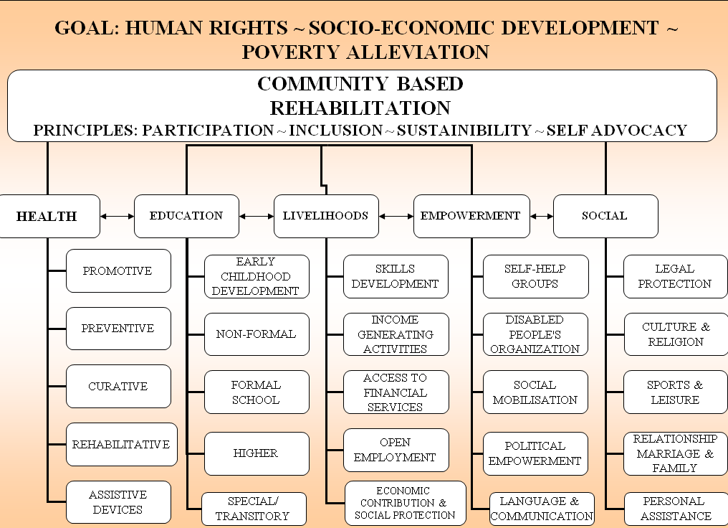

Slide 27
National Policies

Slide 28
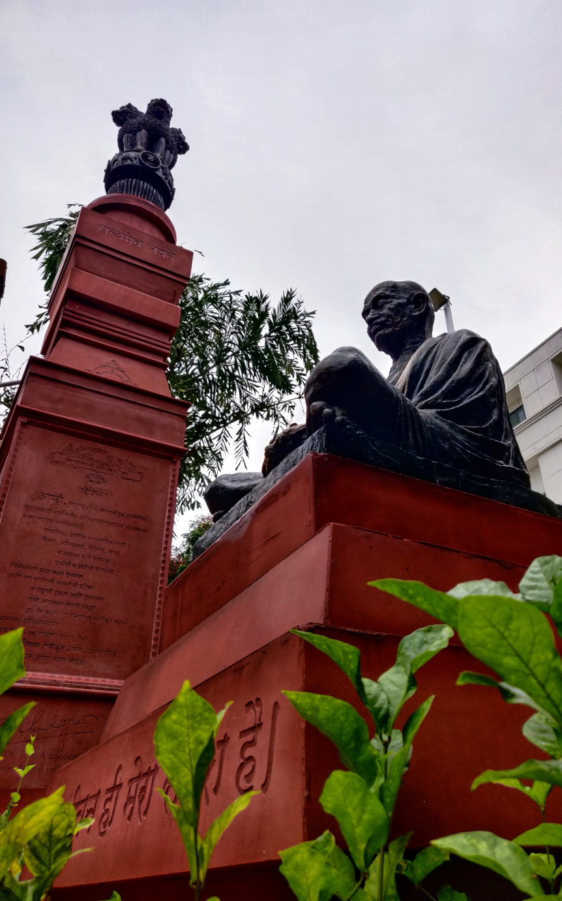

Slide 30
According to the Census 2001, there are 2.19 crore persons with disabilities in India who constitute 2.13 percent of the total population.
This includes persons with visual, hearing, speech, locomotor and mental disabilities.
75% of PWD - rural areas
49% are literate and only 34% are employed.
The earlier emphasis on medical rehabilitation has now been replaced by an emphasis on social rehabilitation.

Slide 31
The Government of India has enacted three legislations for persons with disabilities viz.
Persons with Disability (Equal Opportunities, Protection of Rights and Full Participation) Act, 1995, which provides education, employment, creation of barrier free environment, social security, etc.
National Trust for Welfare of Persons with Autism, Cerebral Palsy, Mental Retardation and Multiple Disability Act, 1999 has provisions for legal guardianship of the four categories and creation of enabling environment for as much independent living as possible.
Rehabilitation Council of India Act, 1992 deals with the development of manpower for providing rehabilitation services.

Slide 32
In addition to the legal framework, extensive infrastructure has been developed
Institute for the Physically Handicapped, New Delhi.
National Institute of Visually Handicapped, Dehradun
National Institute for Orthopaedically Handicapped, Kolkata
National Institute for Mentally Handicapped, Secunderabad.
National Institute for Hearing Handicapped, Mumbai
National Institute of Rehabilitation Training & Research, Cuttack.
National Institute for Empowerment of Persons with Multiple Disabilities, Chennai.

Slide 33
Focus on policies
Prevention of Disabilities
Rehabilitation Measures
Women with disabilities
Children with Disabilities
Barrier-free environment
Issue of Disability Certificates
Social Security
Promotion of Non-Governmental Organizations (NGOs)
Collection of regular information on Persons with Disabilities
Research
Sports, Recreation and Cultural life

Slide 34
Five Composite Rehabilitation Centres
Four Regional Rehabilitation Centres
120 District
Disability Rehabilitation Centres (DDRCs)

Slide 35
National Institutions under MoHFW
National Institute of Mental Health and Neuro Sciences, Bangalore
All India Institute of Physical Medicine and Rehabilitation, Mumbai
All India Institute of Speech and Hearing,Mysore
Central Institute of Psychiatry, Ranchi

Slide 36
National Handicapped and Finance Development Corporation (NHFDC) has been providing loans on concessional terms for undertaking self-employment ventures by the persons with disabilities through State Channelizing Agencies.
Panchayati Raj Institutions at Village level, Intermediary level and District level have been entrusted with the welfare of persons with disabilities.
India is a signatory to the Declaration on the Full Participation and Equality of People with Disabilities in the Asia Pacific Region.
India is also a signatory to the Biwako Millennium Framework for action towards an inclusive, barrier free and rights based society.
India is currently participating in the negotiations on the UN Convention on Protection and Promotion of the Rights and Dignity of Persons with Disabilities.

Slide 37
CBR Vs IBR

Slide 38
CBR
Community Based Rehabilitation
IBR
Institution Based Rehabilitation

Slide 39
CBR Vs IBR
Approach – Scientific – Holistic & comprehensive
Goal of training – Reentry to community – Discharge from hospital
Skilled personnel care – Limited – Easily available
Competency of resources – Trained – Professional trained
Advanced technique / Rx – Not possible – Possible
Cost of Treatment - Cheaper - Costly
Accessibility of services - Accessible to all – Limited
Ext of services – Can be done without much cost - Not possible
Quality of service – Fair – Good

Slide 40
Active participation – Ensured - Recommended
Community interaction – Done – Ignored
Social rehab – Possible - Usually disregarded
Psychological Rehab – Possible – Ignored
Socio-economic status – Considered – Not considered
Promotion of awareness – Yes – Not practiced
Duration – Long term – Short term
Evaluation – Difficult – Possible

Slide 41
National Policies

Slide 43
Responsibilities on implementation

Slide 44
Ministry of Social Justice & Empowerment – Nodal ministry
Ministries
Home Affairs,
Department
Elementary Education & Literacy, Secondary & Higher Education,
Health & Family Welfare,
Rural Development & Urban Development,
Youth Affairs & Sports,
Railways,
Science & Technology,
Statistics & Programme Implementation,
Labour,
Panchayati Raj
Road Transport & Highways,
Public Enterprises, Revenue, Women & Child Development,
Information Technology and Personnel & Training

Slide 45
REHABILITATION TEAM

Slide 47
Multidisciplinary draws on knowledge from different disciplines but stays within their boundaries.
Interdisciplinary analyzes, synthesizes and harmonizes links between disciplines into a coordinated and coherent whole.
Creating a unity of intellectual frameworks beyond the disciplinary perspective.

Slide 60
SPECIAL EDUCATOR
CBR PROJECT MANAGER / DIRECTOR
PATIENT
FAMILY MEMBERS

Slide 67
Shabaaz ……

